Slide 1

Topics
Module 1 : Evolution of HPC
Module 2 : CPU vs GPU
Module 3 : CUDA Programming
Module 4 : Kernel Launch
Module 5 : Flow of a CUDA program
Module 6 : Memory flow and Profiling CUDA programs

Slide 3
Module 1 : Evolution of HPC

Slide 4
Agenda
Evolution of HPC
Architecture innovations
System performance from parallelism

Slide 5
Evolution of HPC System
Memory
CPU
Sequential program
Mega Flops

Slide 6
Evolution of HPC System
Memory
Memory
CPU
CPU
CPU
Sequential program
Mega Flops
Shared Memory
Giga Flops
Parallel programs using OpenMP and MPI

Slide 7
Evolution of HPC System
Memory
Memory
Memory
Memory
…….
CPU
CPU
CPU
CPU
CPU
NETWORK
Sequential program
Mega Flops
Shared Memory
Giga Flops
Parallel programs using OpenMP and MPI
Multiple nodes
Tera Flops
Infiniband (200Gbps)
Distributed memory

Slide 8
Architecture innovations
Architecture innovations

Slide 9
Architecture innovations
Architecture innovations
Width: 8 bit to 16 bit to 64 bit

Slide 10
Architecture innovations
Architecture innovations
Width: 8 bit to 16 bit to 64 bit
Multicore: single processor to multi cores

Slide 11
Architecture innovations
Architecture innovations
Width: 8 bit to 16 bit to 64 bit
Multicore: single processor to multi cores
Instructions per cycle: 4-10 cycles per instructions to 4+ instructions per cycle

Slide 12
Architecture innovations
Architecture innovations
Width: 8 bit to 16 bit to 64 bit
Multicore: single processor to multi cores
Instructions per cycle: 4-10 cycles per instructions to 4+ instructions per cycle
Clock rate : 3MHz to 4GHz

Slide 13
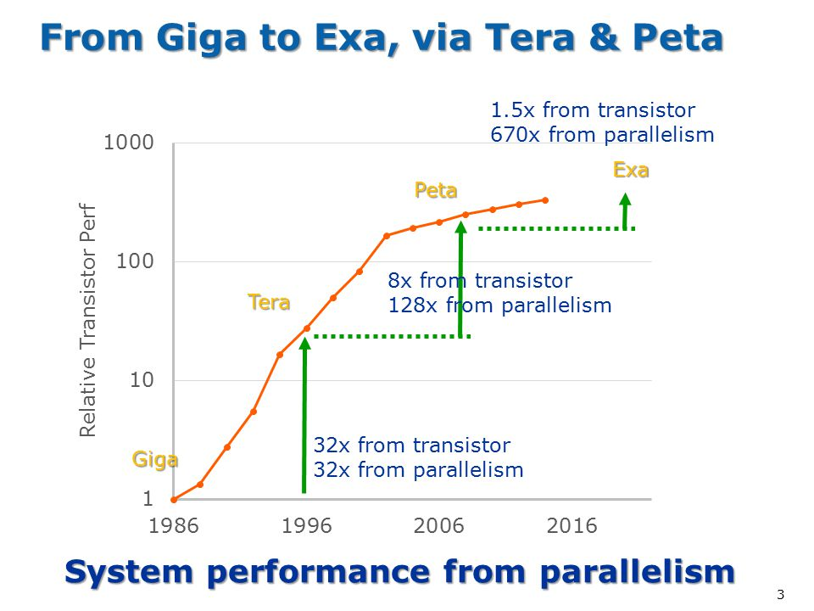
System performance from parallelism
https://www.exascaleproject.org/

Slide 15
Module 2 : CPU vs GPU

Slide 16
Agenda
CPU architecture
Silicon budget
GPU architecture
CPU vs GPU

Slide 17
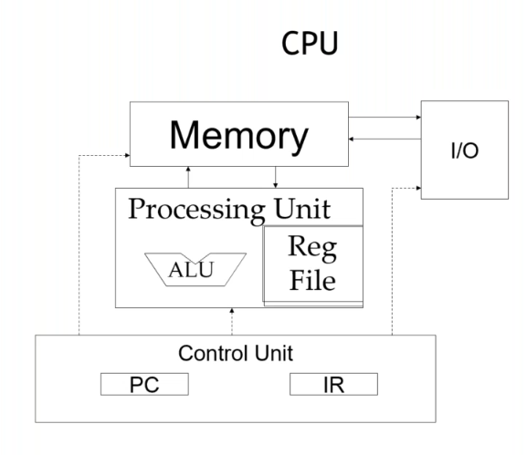
CPU : Von Neumann

Slide 18
CPU vs GPU : Silicon Budget
Number of transistors
 | CPU | GPU
ALU | Less
Control | More
Cache | More

Slide 19
CPU vs GPU : Silicon Budget
Number of transistors
 | CPU | GPU
ALU | Less | More
Control | More | Less
Cache | More | Less

Slide 20
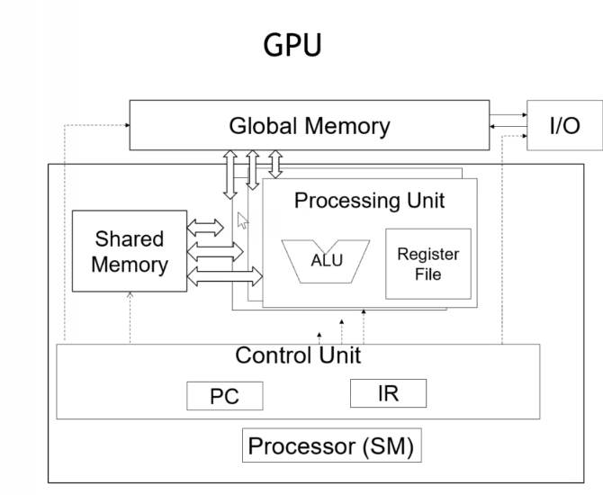
GPU : Von Neumann

Slide 21
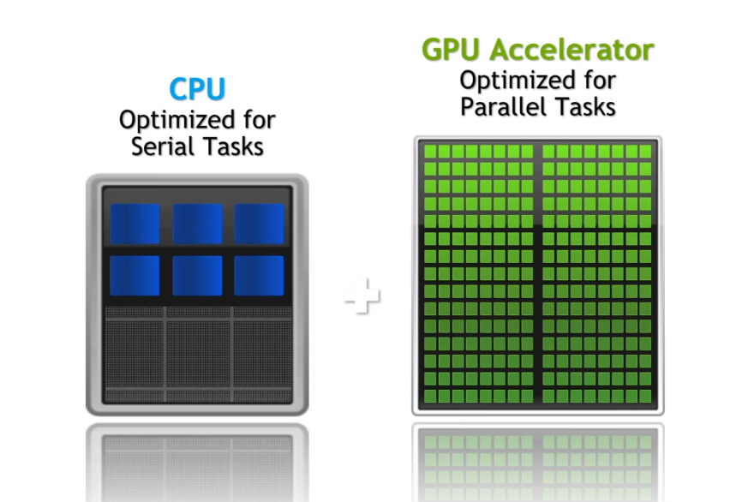
CPU vs GPU : Silicon Budget

Slide 22
CPU vs GPU
CPU | GPU

Slide 23
CPU vs GPU
CPU | GPU
Small number of large cores | Large number of small cores

Slide 24
CPU vs GPU
CPU | GPU
Small number of large cores | Large number of small cores
Low latency | High throughput

Slide 25
CPU vs GPU
CPU | GPU
Small number of large cores | Large number of small cores
Low latency | High throughput
Optimized for serial processing | Optimized for parallel processing

Slide 26
CPU vs GPU
CPU | GPU
Small number of large cores | Large number of small cores
Low latency | High throughput
Optimized for serial processing | Optimized for parallel processing
Designed for running complex programs | Designed for repetitive and complex calculations

Slide 27
CPU vs GPU
CPU | GPU
Small number of large cores | Large number of small cores
Low latency | High throughput
Optimized for serial processing | Optimized for parallel processing
Designed for running complex programs | Designed for repetitive and complex calculations
Cost efficient for smaller workloads | Cost efficient for bigger workloads

Slide 29
Module 3 : CUDA Programming

Slide 30
Agenda
Basics of CUDA programming
GPU architecture
Streaming multiprocessors
Elements in CUDA program
Organization of threads in CUDA

Slide 31

CUDA
CUDA : Compute Unified Device Architecture

Slide 32
CUDA
CUDA : Compute Unified Device Architecture
Run programs by utilizing power of GPUs

Slide 33
CUDA
CUDA : Compute Unified Device Architecture
Run programs by utilizing power of GPUs
Extension of C/C++ that allows CPUs and GPUs to work together

Slide 34

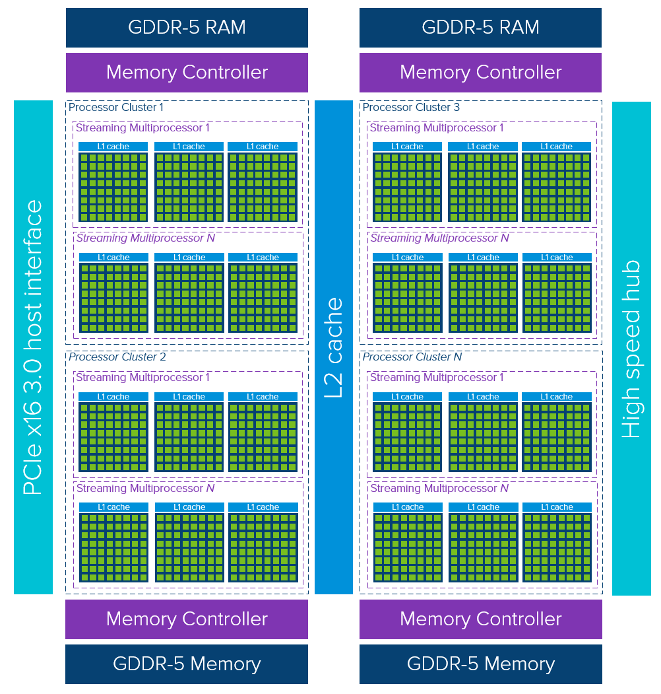
GPU Architecture

Slide 35
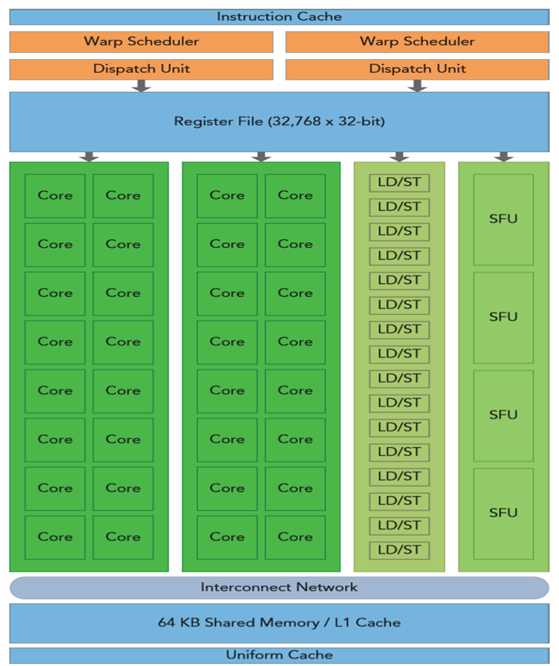
Streaming Multiprocessors
Core
LD/ST - Load and store units
SFU - Special Function units
Warp Scheduler

Slide 36
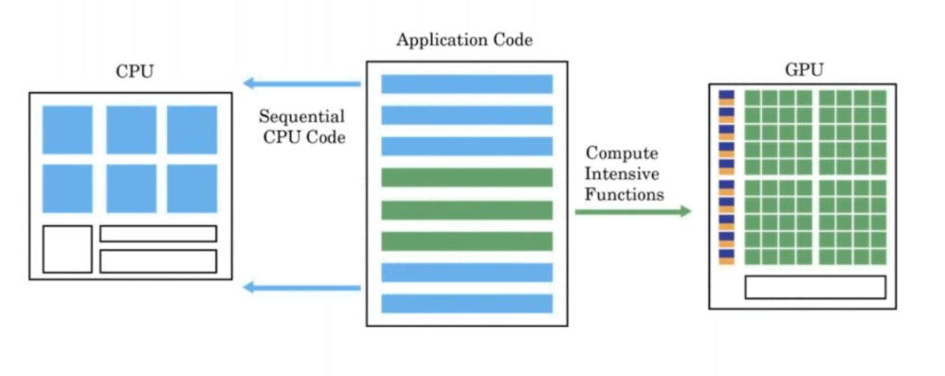
GPU Programming Paradigm

Slide 37
Elements of CUDA program
Host code
Device code

Slide 38
Elements of CUDA program
Host code - code that runs on CPU
Device code - code that runs on GPU
__global__ void cuda_hello(){
printf("Hello World from GPU!\n");
}
int main() {
cuda_hello<<<1,1>>>();
return 0;
}

Slide 39
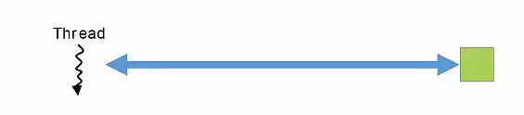
Organization of threads

Slide 40
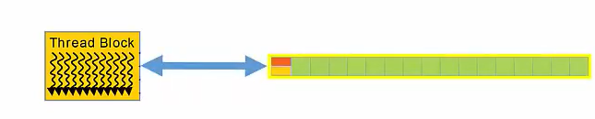
Organization of threads

Slide 41
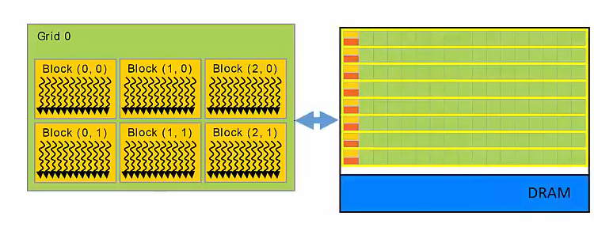
Organization of threads

Slide 42
Organization of threads
Threads
Kernel executes as a set of threads
Blocks
Threads are grouped into blocks
Grids
Blocks are grouped into grids
Kernel executes as a Grid of Blocks of Threads

Slide 43
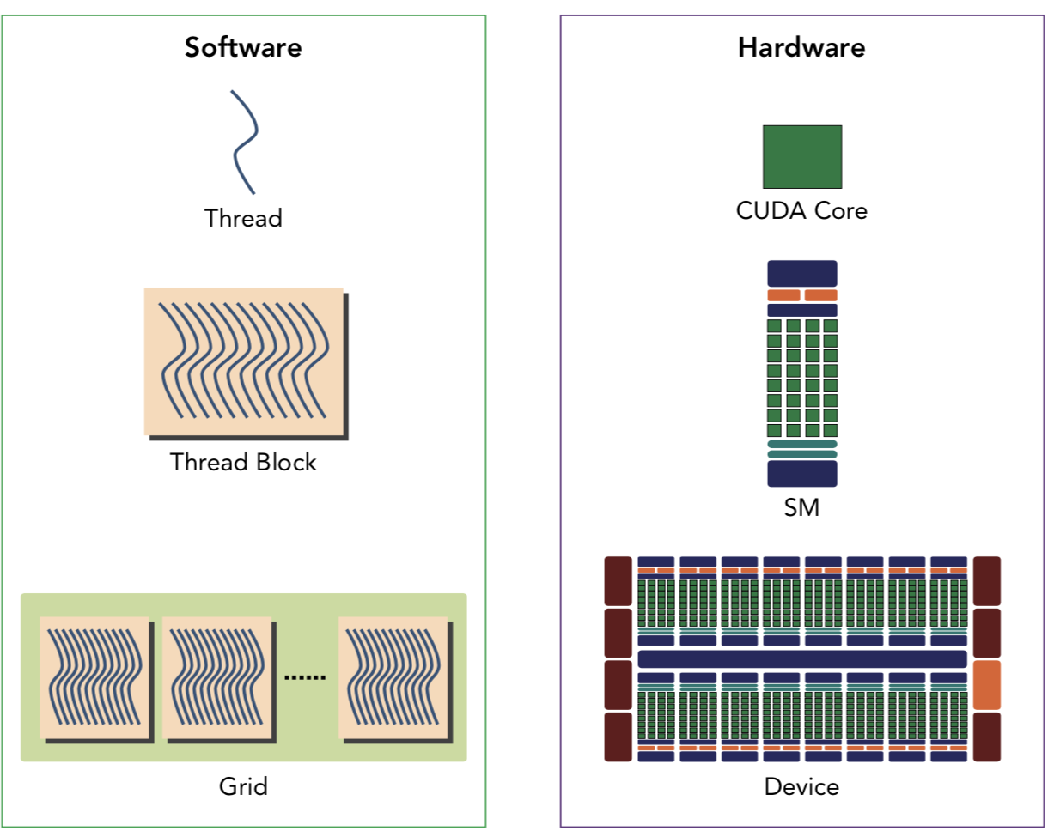
Software abstraction

Slide 44
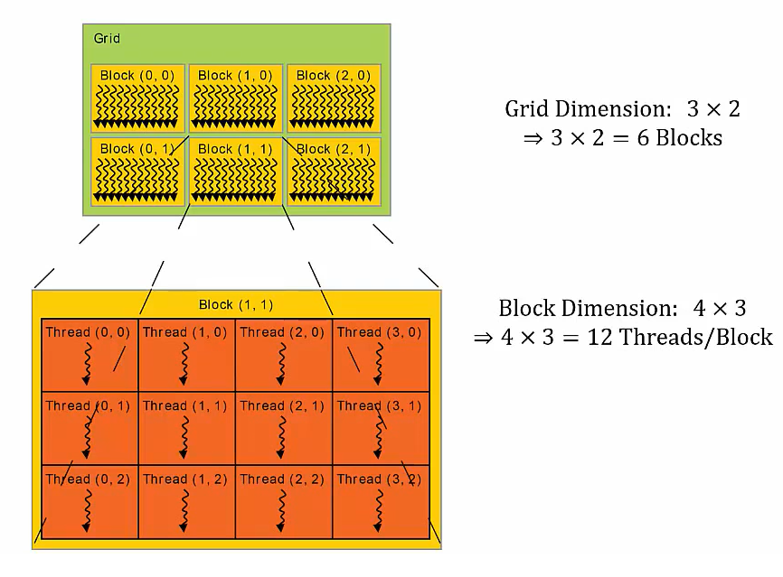
Dimensions of Grids and Blocks
Grid dimension
Block structure of each grid
1d, 2d or 3d
Block dimension
Thread structure of each block
1d or 2d or 3d

Slide 45
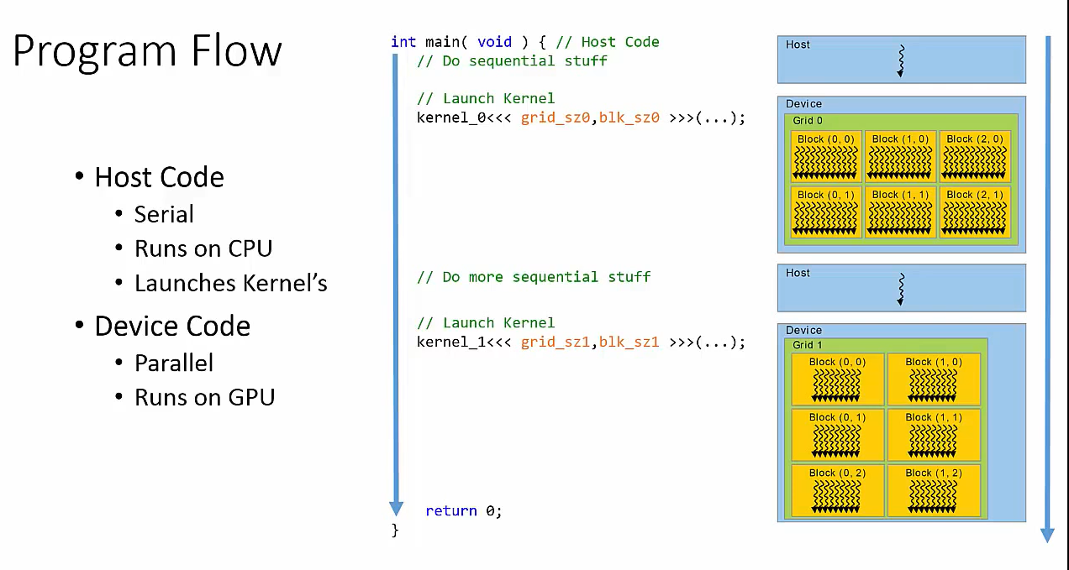
Dimensions of Grids and Blocks

Slide 47
Module 4 : Kernel Launch

Slide 48
Agenda
Kernel launch syntax
Function qualifiers
Organization of threads in blocks and grids

Slide 49
Kernel Launch Syntax
Launch kernel
KernelName <<< grid_size, block_size >>> (...)

Slide 50
Kernel Launch Syntax
Launch kernel
KernelName <<< grid_size, block_size >>> (...)
KernelName <<< no_of_blocks, threads_per_block >>> (...)

Slide 51
Kernel Launch Syntax
dim3 variable
dim3 grid_size (x, y, z)
dim3 block_size (x, y, z)
Launch kernel
__global__ KernelName <<< grid_size, block_size >>> (...)
__global__ KernelName <<< no_of_blocks, threads_per_block >>> (...)

Slide 52
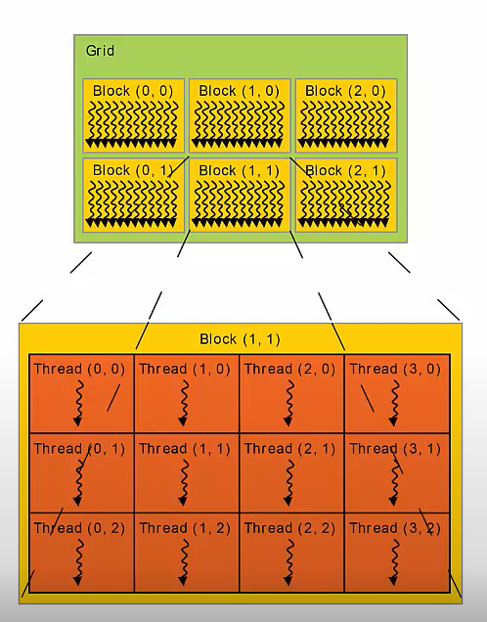
Kernel Launch
// dim3 variable
dim3 grid_size (3, 2)
dim3 block_size (4, 3)
// Launch kernel
__global__ KernelName <<< grid_size, block_size >>> (...)

Slide 53
Function qualifiers
Function qualifiers
Keywords used to specify the behavior and characteristics of functions that execute on the GPU.
Precedes the function declaration
Provide additional information to the CUDA compiler and runtime system

Slide 54
Function qualifiers
 | Executed on | Only callable from
__global__ | device | host

Slide 55
Function qualifiers
 | Executed on | Only callable from
__device__ | device | device
__global__ | device | host

Slide 56
Function qualifiers
 | Executed on | Only callable from
__device__ | device | device
__global__ | device | host
__host__ | host | host

Slide 57
1 Block - threads in 1D
int main()
{
fun <<< 1, 10 >>> ();
}
__global__ void fun()
{
int tx = threadIdx.x;
printf(“%d”, tx);
}
0 1 2 3 4 5 6 7 8 9

Slide 58
1 Block - threads in 2D
int main()
{
dim3 threadsPerBlock(5, 2);
fun <<< 1, threadsPerBlock >>> ();
}
__global__ void fun()
{
int tx = threadIdx.x;
int ty = threadIdx.y;
printf(“%d %d”, tx, ty);
}
0 1 2 3 4
0
1

Slide 59
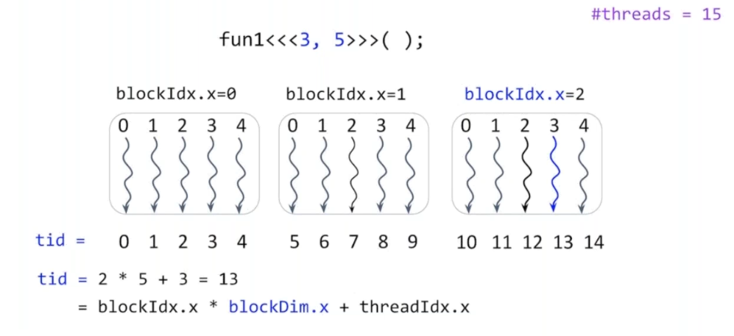
Blocks in 1D -threads in 1D

Slide 60
Blocks in 1D -threads in 1D

Slide 62
Module 5 : Flow of a CUDA program

Slide 63
Agenda
Flow of a CUDA program
Allocating device memory
Copying data from host to device
Running a CUDA program

Slide 64
Flow of a CUDA program
Allocate host memory and initialize data

Slide 65
Flow of a CUDA program
Allocate host memory and initialize data
Allocate device memory

Slide 66
Flow of a CUDA program
Allocate host memory and initialize data
Allocate device memory
Transfer data from host to device memory

Slide 67
Flow of a CUDA program
Allocate host memory and initialize data
Allocate device memory
Transfer data from host to device memory
Execute kernels

Slide 68
Flow of a CUDA program
Allocate host memory and initialize data
Allocate device memory
Transfer data from host to device memory
Execute kernels
Transfer data from device to host

Slide 69
Flow of a CUDA program
Allocate host memory and initialize data
Allocate device memory
Transfer data from host to device memory
Execute kernels
Transfer data from device to host
Reclaim memory

Slide 70
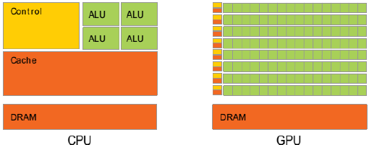
Flow of a CUDA program
int main(void){
// sequential code
}
Host
Host code
Sequential code

Slide 71
Flow of a CUDA program
int main(void){
// sequential code
// Allocate memory on device
cudaMalloc(...)
}
Host
Host code
Sequential code
Allocate memory on device

Slide 72
Flow of a CUDA program
int main(void){
// sequential code
// Allocate memory on device
cudaMalloc(...)
// Copy data from host to device
cudaMemcpy(...)
}
Host
Host code
Sequential code
Allocate memory on device
Copy data from host to device
Copy data from CPU to GPU

Slide 73
Flow of a CUDA program
int main(void){
// sequential code
// Allocate memory on device
cudaMalloc(...)
// Copy data from host to device
cudaMemcpy(...)
// Launch kernel
KernelName <<< grid_size,
block_size >>> (...)
}
Host
Host code
Sequential code
Allocate memory on device
Copy data from host to device
Copy data from CPU to GPU
Launch kernel
Execute threads in parallel on GPU

Slide 74
Flow of a CUDA program
int main(void){
// sequential code
// Allocate memory on device
cudaMalloc(...)
// Copy data from host to device
cudaMemcpy(...)
// Launch kernel
KernelName <<< grid_size,
block_size >>> (...)
// Copy data from device to host
cudaMemcpy(...)
//sequential code
return 0;
}
Host
Host code
Sequential code
Allocate memory on device
Copy data from host to device
Copy data from CPU to GPU
Launch kernel
Execute threads in parallel on GPU
Copy data from device to host
Host

Slide 75
Allocating device memory
In C:
malloc(...)
free(...)

Slide 76
Allocating device memory
In C:
malloc(...)
free(...)
In CUDA:
cudaMalloc(Location, Size)
cudaFree()
Location: Memory location on device to allocate memory
Size: number of bytes to allocate

Slide 77
Copy data from host to device
cudaMemcpy( destination, source, numBytes, direction)

Slide 78
Copy data from host to device
cudaMemcpy( destination, source, numBytes, direction)
Direction
Host to device (cudamemcpyhtod)
Device to host (cudamemcpydtoh)
Device to device (cudamemcpydtod)
Host to Host (cudamemcpyhtoh)

Slide 79
Running a cuda program
Save file with .cu extension
test.cu

Slide 80
Running a cuda program
Save file with .cu extension
test.cu
Load cuda compiler
spack load nvhpc

Slide 81
Running a cuda program
Save file with .cu extension
test.cu
Load cuda compiler
spack load nvhpc
Compiler the program
nvcc test.cu -o test

Slide 82
Running a cuda program
Save file with .cu extension
test.cu
Load cuda compiler
spack load nvhpc
Compiler the program
nvcc test.cu -o test
Run the executable
./test

Slide 84
Module 6 : Memory Flow

Slide 85
Agenda
Memory flow in CUDA
CUDA vector addition program
Profiling CUDA programs

Slide 86
Memory hierarchy
Thread
Registers
Reg
Reg
Reg
Reg

Slide 87
Memory hierarchy
Thread
Registers
Thread
Local memory
Reg
Reg
Reg
Reg
LM
LM
LM
LM

Slide 88
Memory hierarchy
Thread
Registers
Thread
Local memory
Block of threads
Shared memory
Reg
Reg
Reg
Reg
LM
LM
LM
LM
Shared memory

Slide 89
Memory hierarchy
Thread
Registers
Thread
Local memory
Block of threads
Shared memory
All blocks
Global memory
Reg
Reg
Reg
Reg
Reg
Reg
Reg
Reg
LM
LM
LM
LM
LM
LM
LM
LM
Shared memory
Shared memory
Global memory

Slide 90
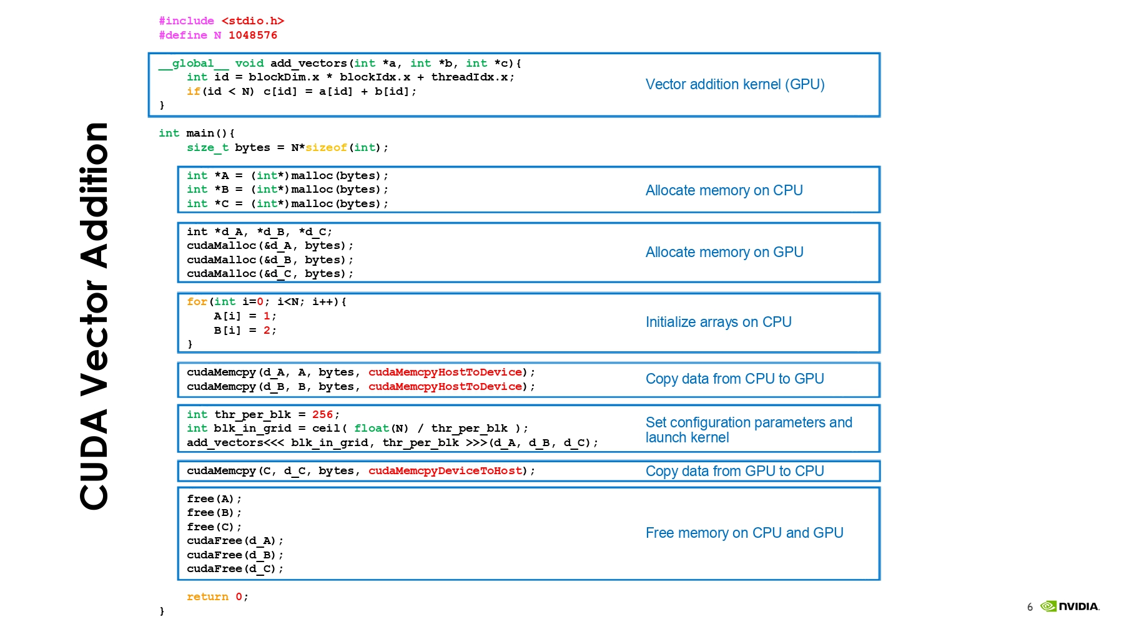
CUDA Vector Addition Program

Slide 91
CUDA Vector Addition Program

Slide 92
CUDA Vector Addition Program

Slide 93
CUDA Vector Addition Program

Slide 94
CUDA Vector Addition Program

Slide 95
CUDA Vector Addition Program

Slide 96
CUDA Vector Addition Program

Slide 97
Profiling CUDA programs
What is profiling?

Slide 98
Profiling CUDA programs (contd…)
What is profiling?
Detecting which function takes how much time
How many times a function is executed

Slide 99
Profiling CUDA programs (contd…)
What is profiling?
Detecting which function takes how much time
How many times a function is executed
nvprof ./<executable_name>

Slide 100
Profiling CUDA programs (contd…)
What is profiling?
Detecting which function takes how much time
How many times a function is executed
nvprof ./<executable_name>
nvprof --query-metrics to list all query metric present in nvprof

Slide 101
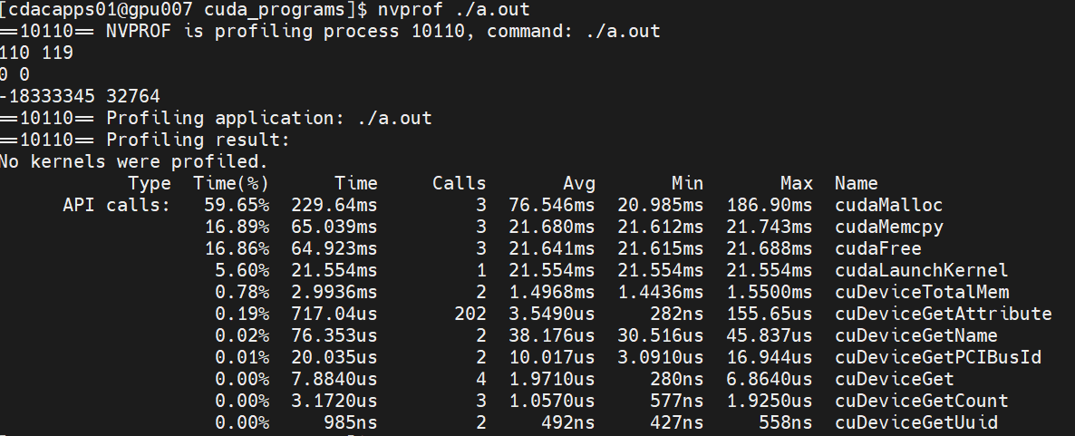
Profiling CUDA programs (contd…)

Slide 102
Summary
CPU vs GPU architecture
CUDA programming basics
Flow of a cuda program
Memory flow of CUDA
Profiling CUDA programs

